Slide 1
Info Visualization
Drobnitchi Daniel-Nicusor,
Suto Robert-Lucian

Slide 2
The Dataset
01

Slide 3
The Dataset
The final dataset that we have chosen is comprised of two separate datasets, showing flight informations in 2015 and 2019 respectively. Those contain information about delays, cancellations, dates, distances and the companies that operated those flights.

Slide 4
The Dataset
The final dataset is structured on 32 columns and contains about 9 million rows of information. It is based only on US-based companies but contains national as well as international flights.

Slide 5
PowerBI Visualisations
3

Slide 6
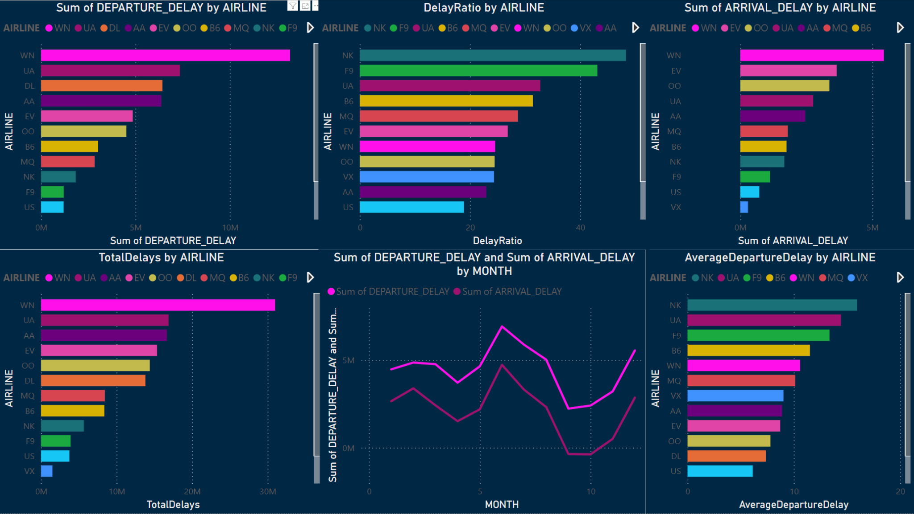
Delays Sheet

Slide 7
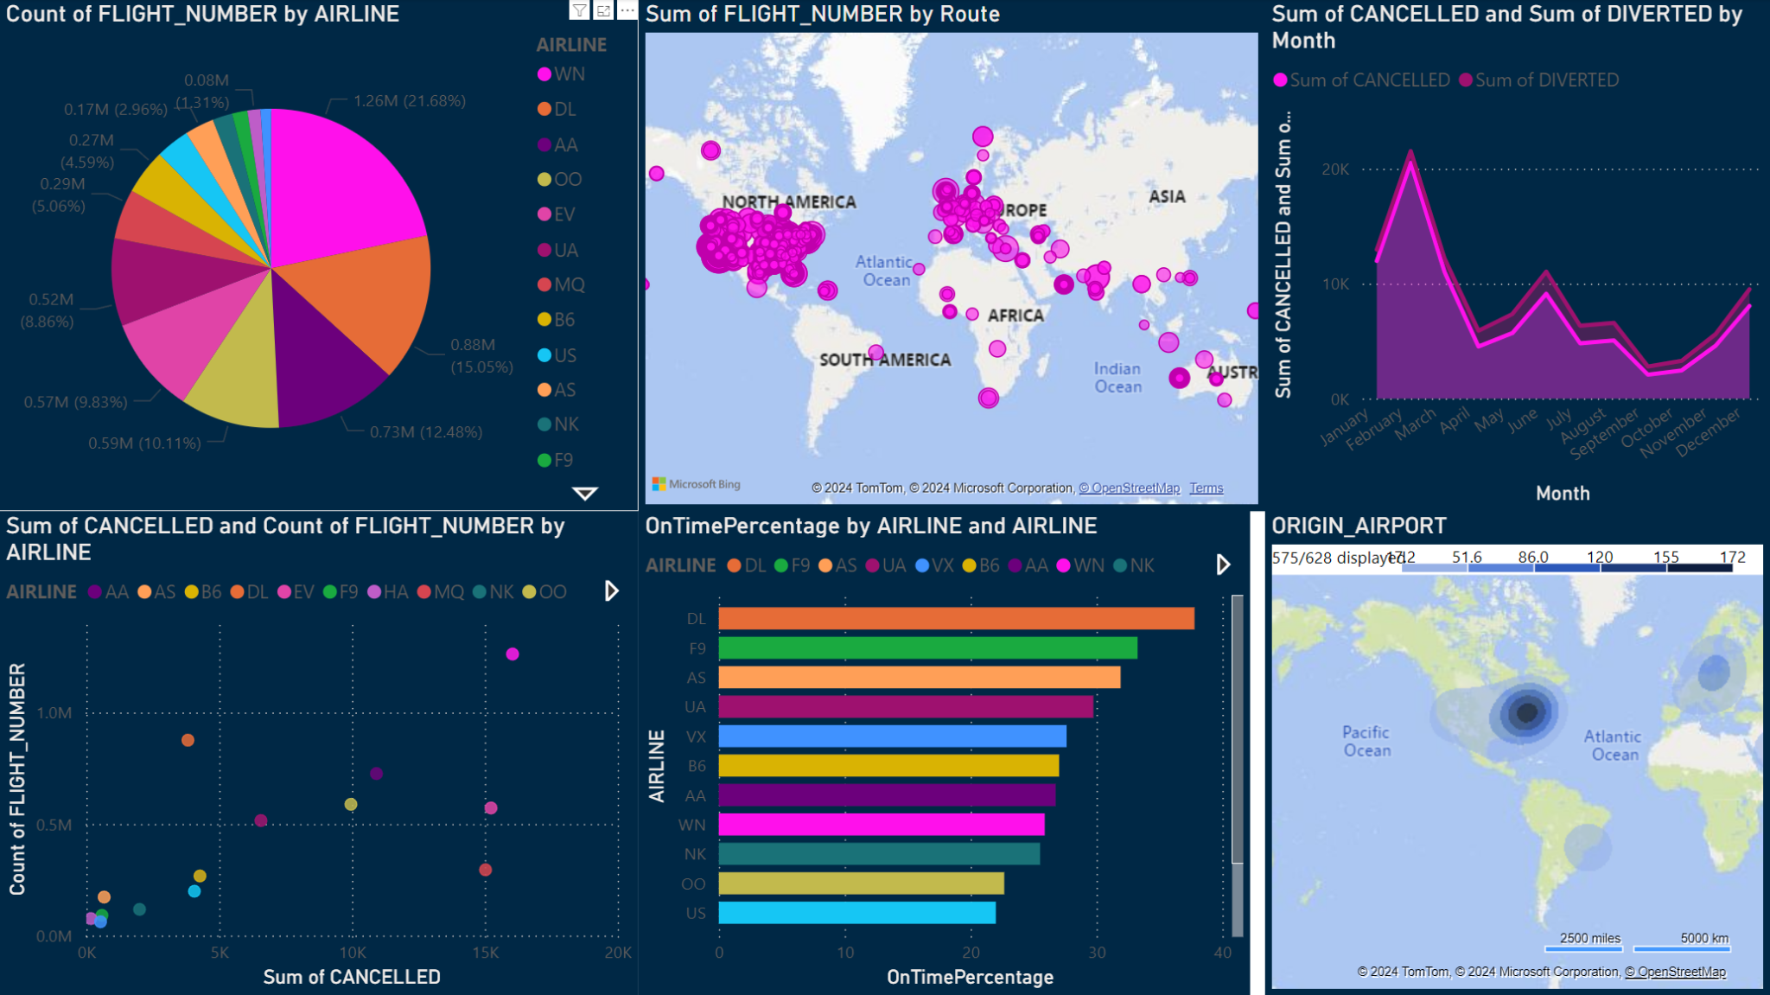
Stats Sheet

Slide 8
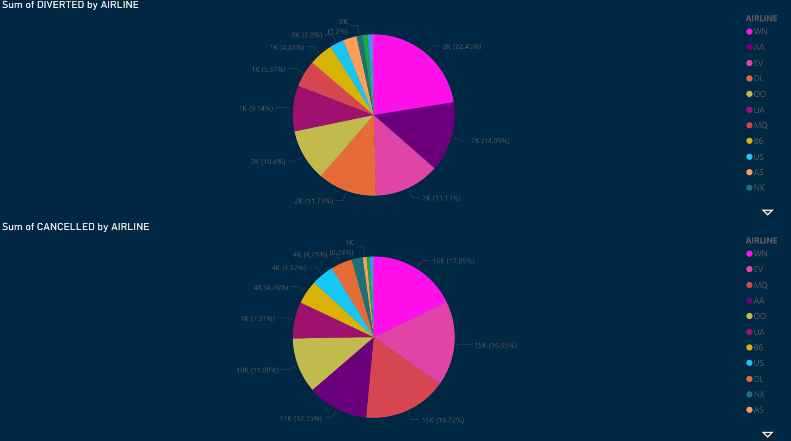
Diverted / Cancelled Sheet

Slide 9
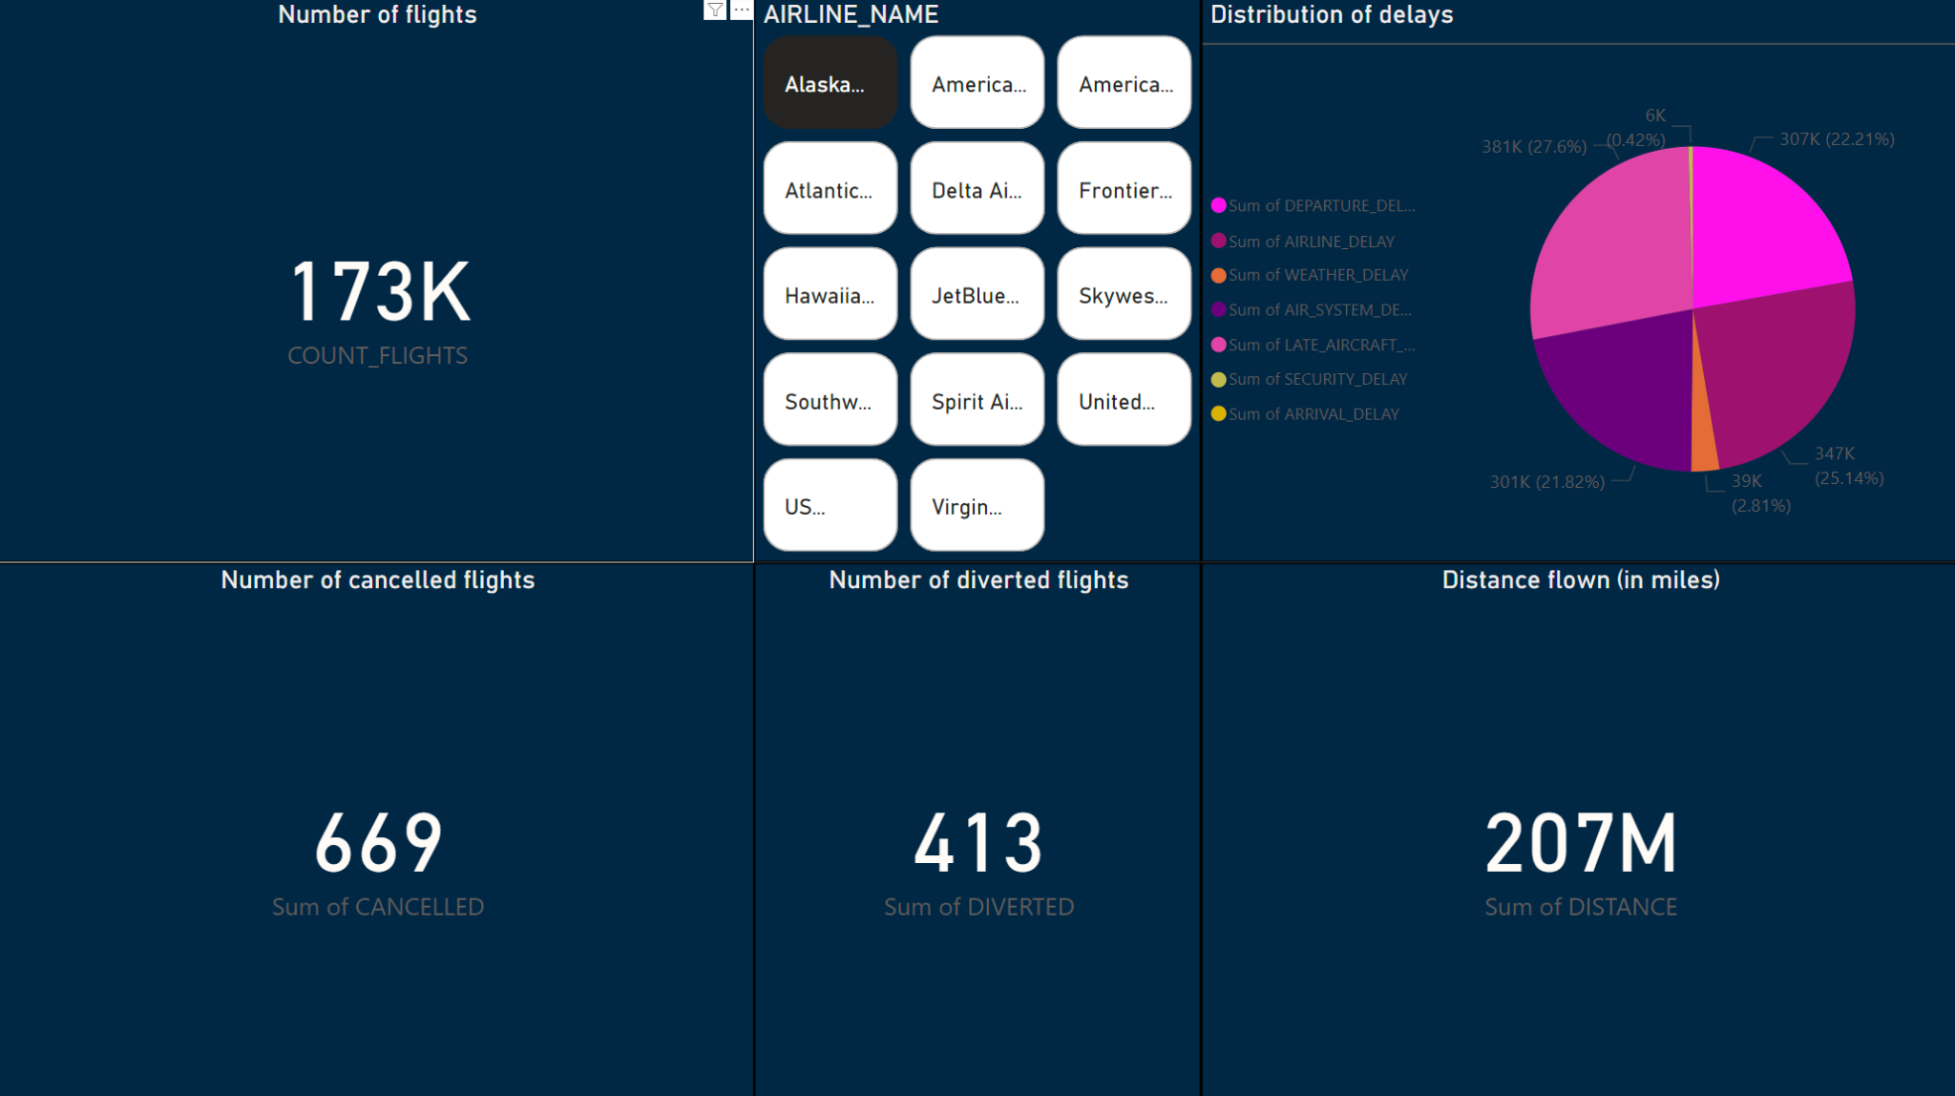
Airline Filter Sheet

Slide 10
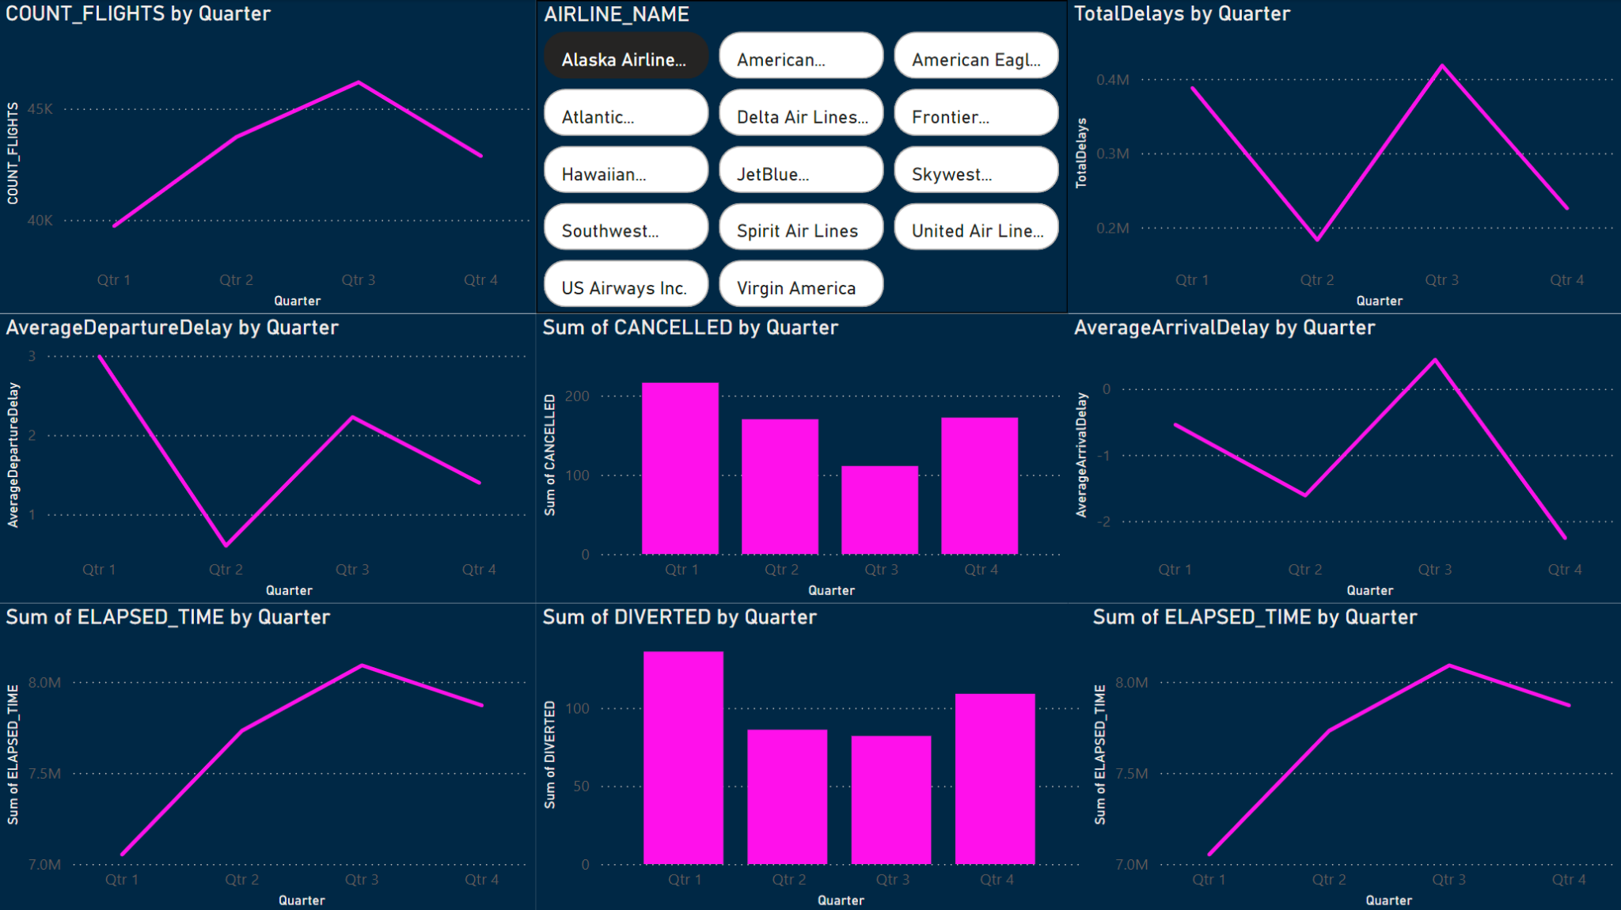
Quarterly Reports Sheet

Slide 11
Python Visualisations
4

Slide 12
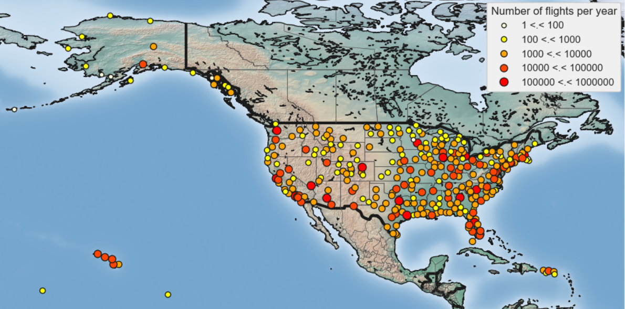
Basemap of flights

Slide 13
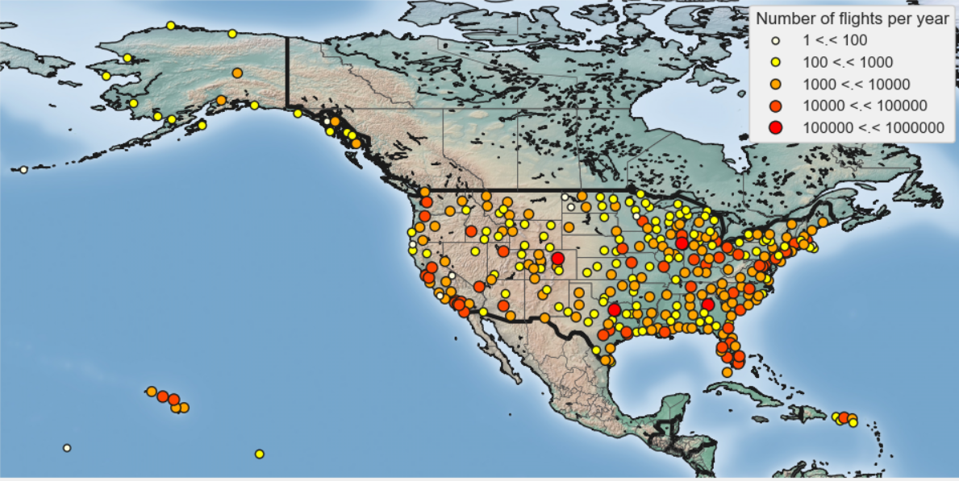
Basemap of flights

Slide 14
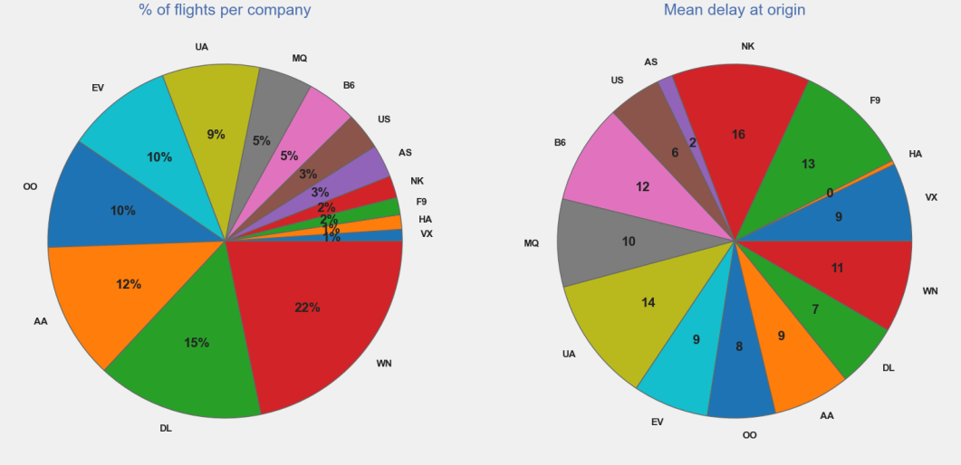
Flights, delays and companies

Slide 15
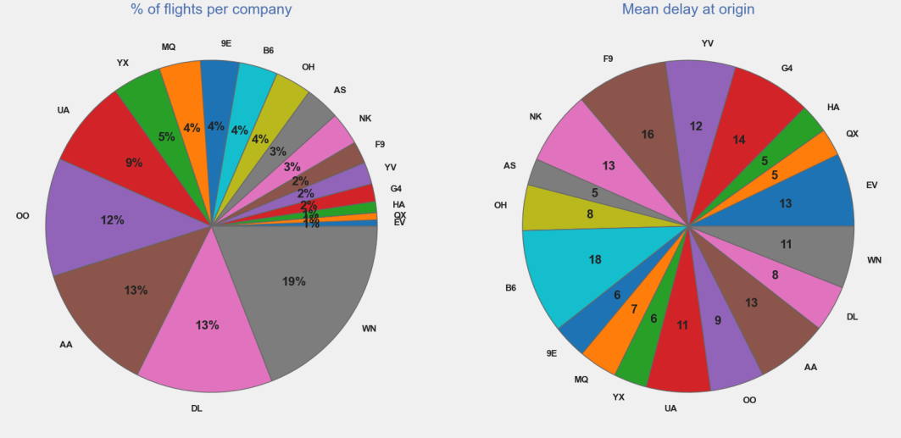
Flights, delays and companies

Slide 16
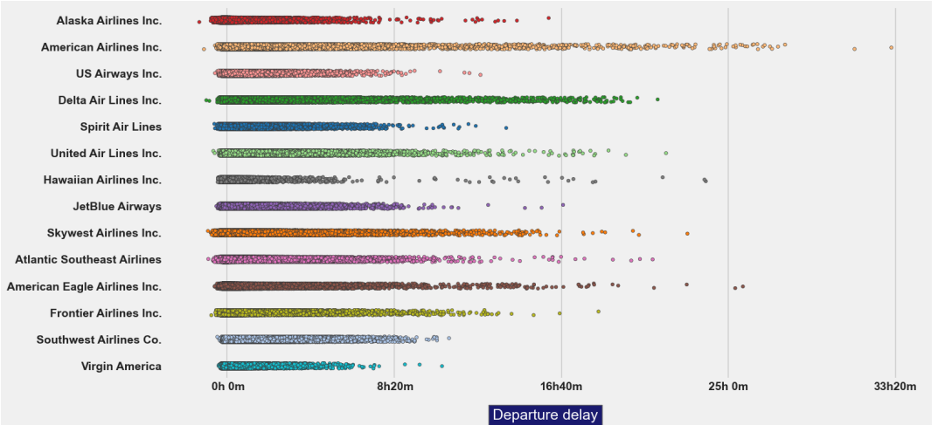
Flights, delays and companies

Slide 17
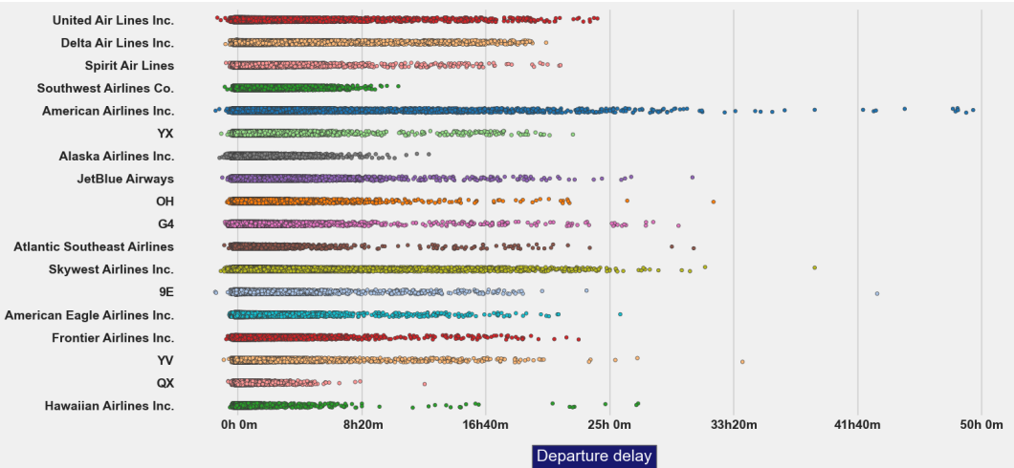
Flights, delays and companies

Slide 18
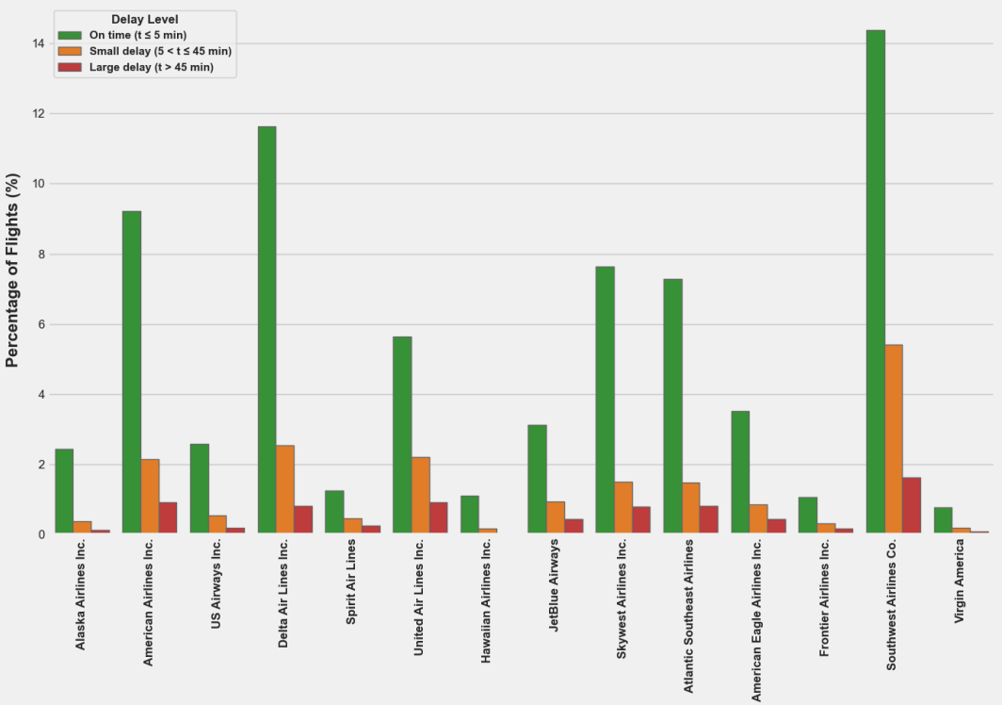
Delays compared to on time

Slide 19
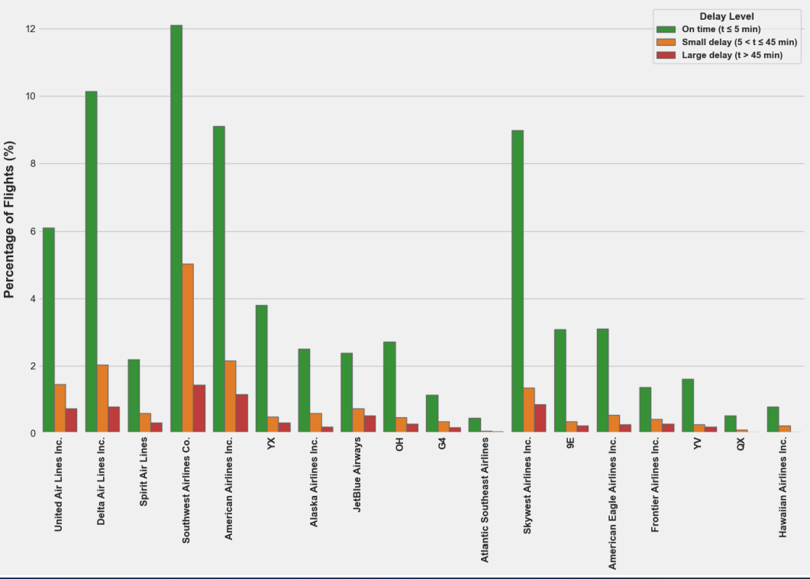
Delays compared to on time

Slide 20
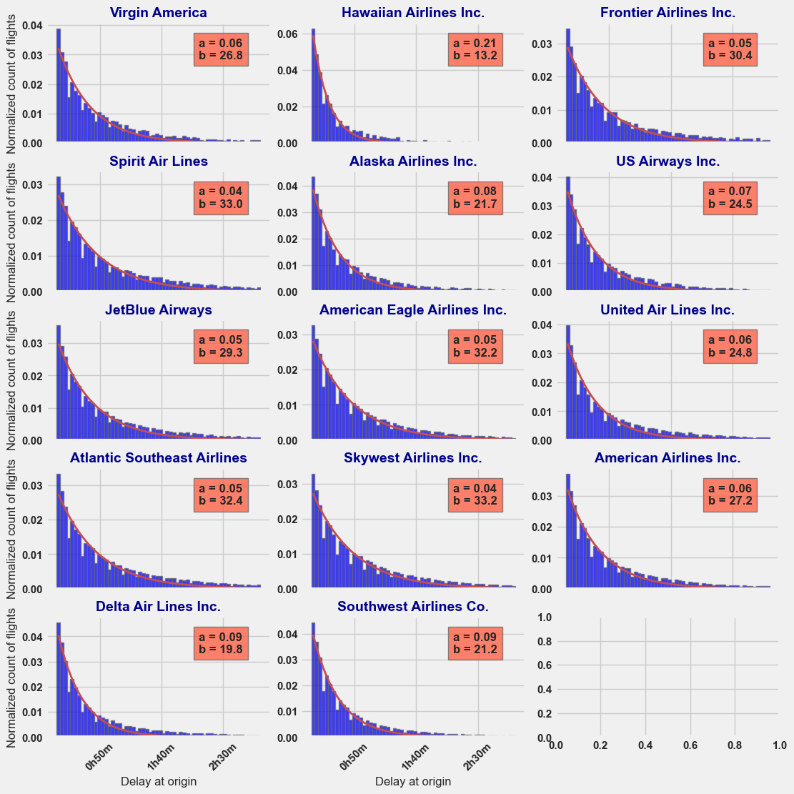
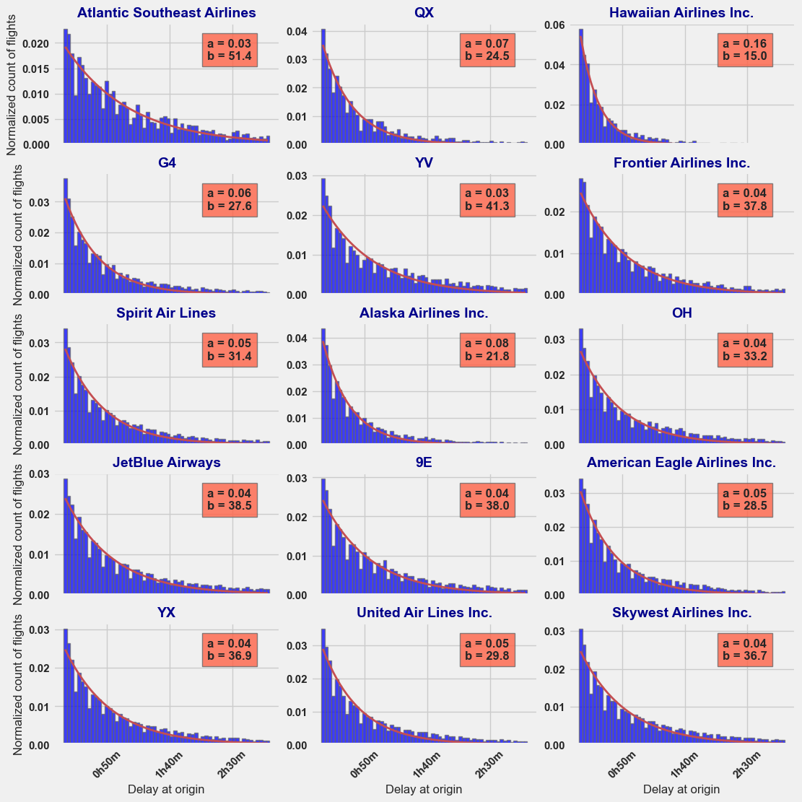
Delays compared to on time

Slide 21
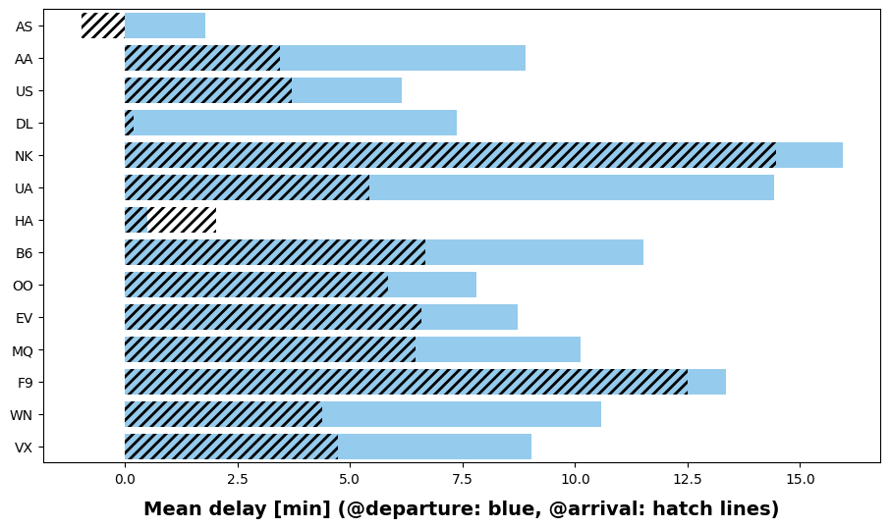
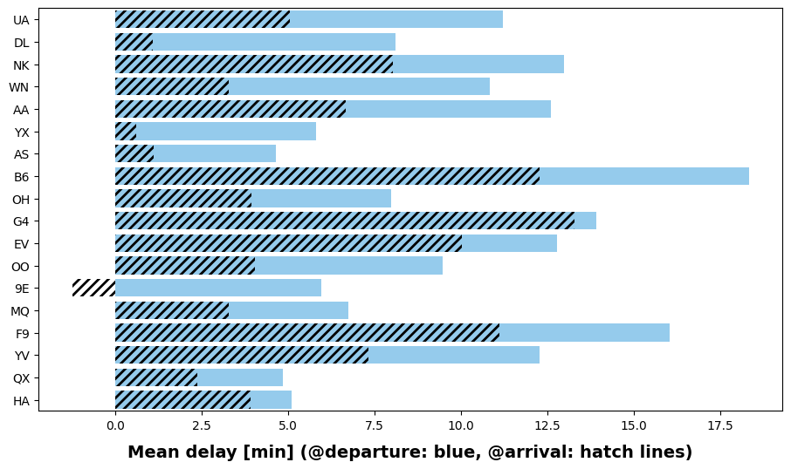
Delays on take-off vs landing

Slide 22
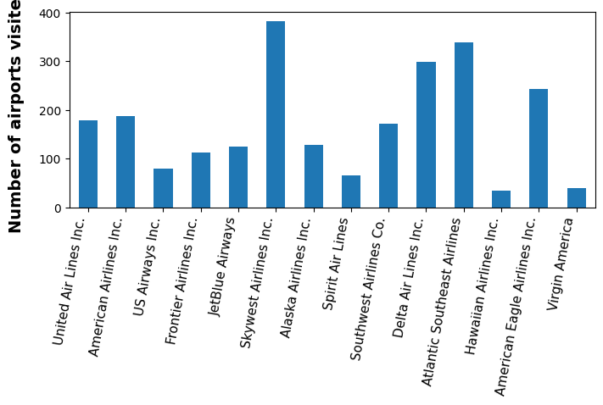
Relations between airport and delays

Slide 23
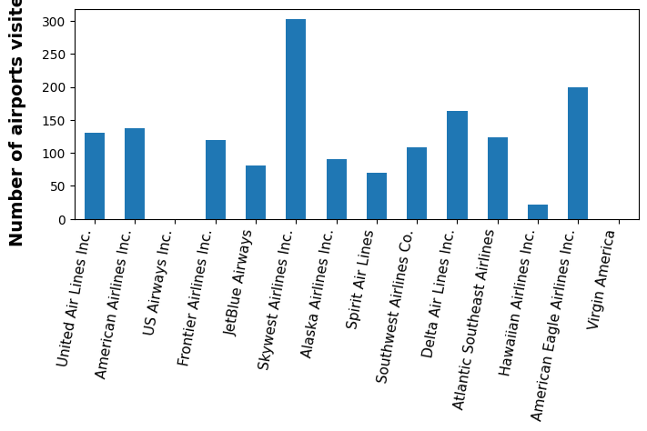
Relations between airport and delays

Slide 24
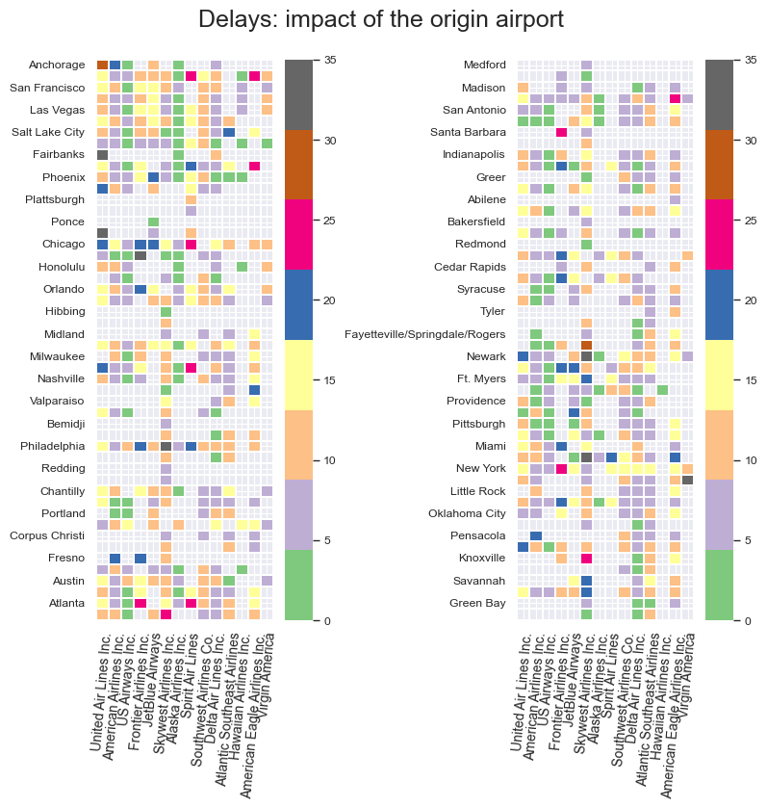
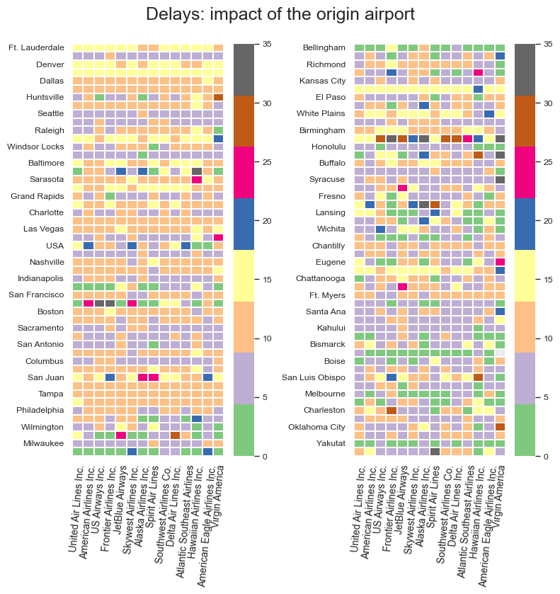
Relations between airport and delays

